Slide 1

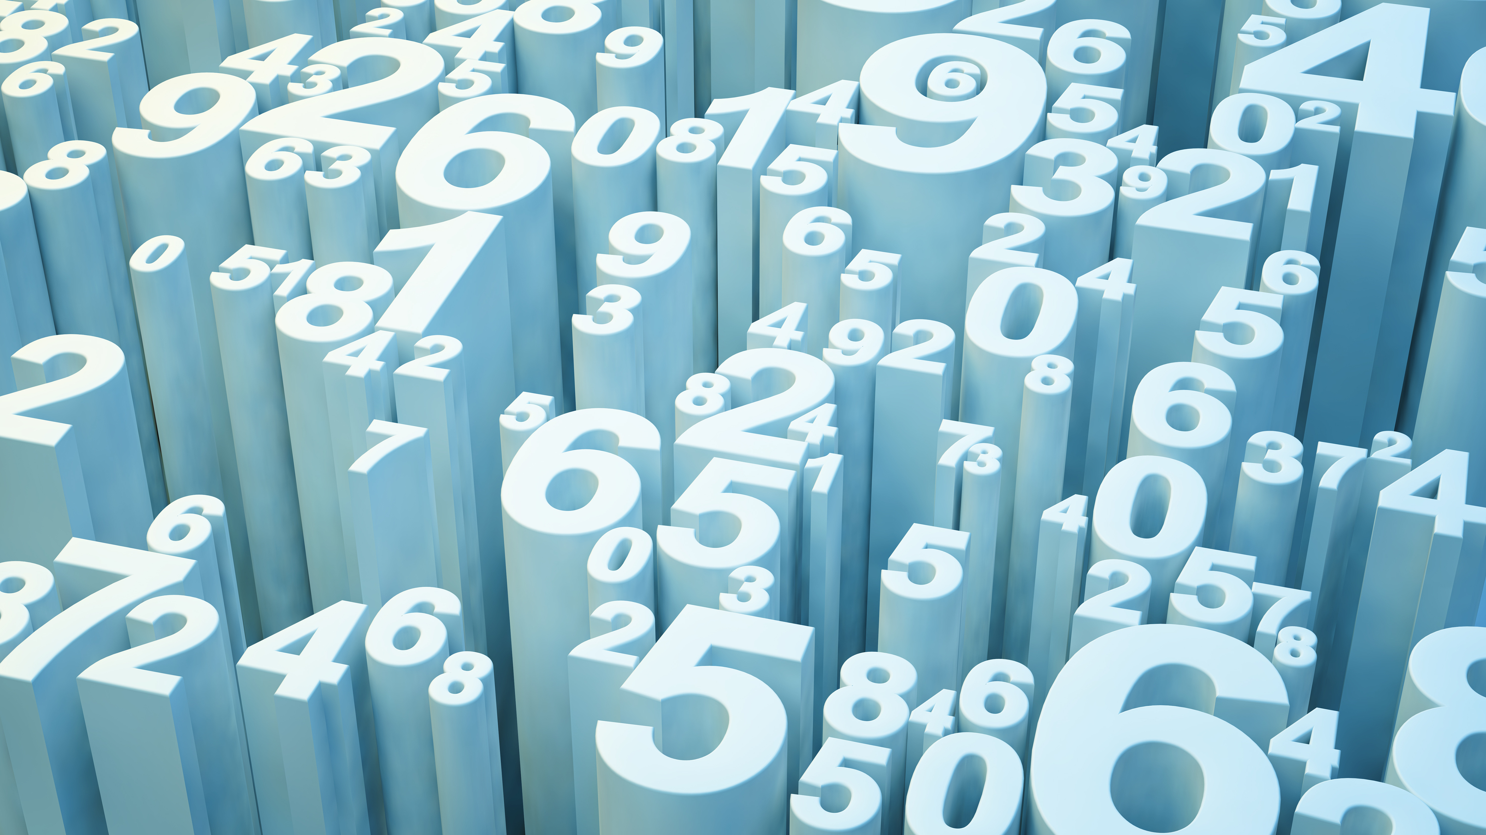
Google Play Store app ratings
Assaf Berman
Ben Pinhasov

Slide 2

Goal
Predict app’s rating by apps market properties and user reviews

Slide 3
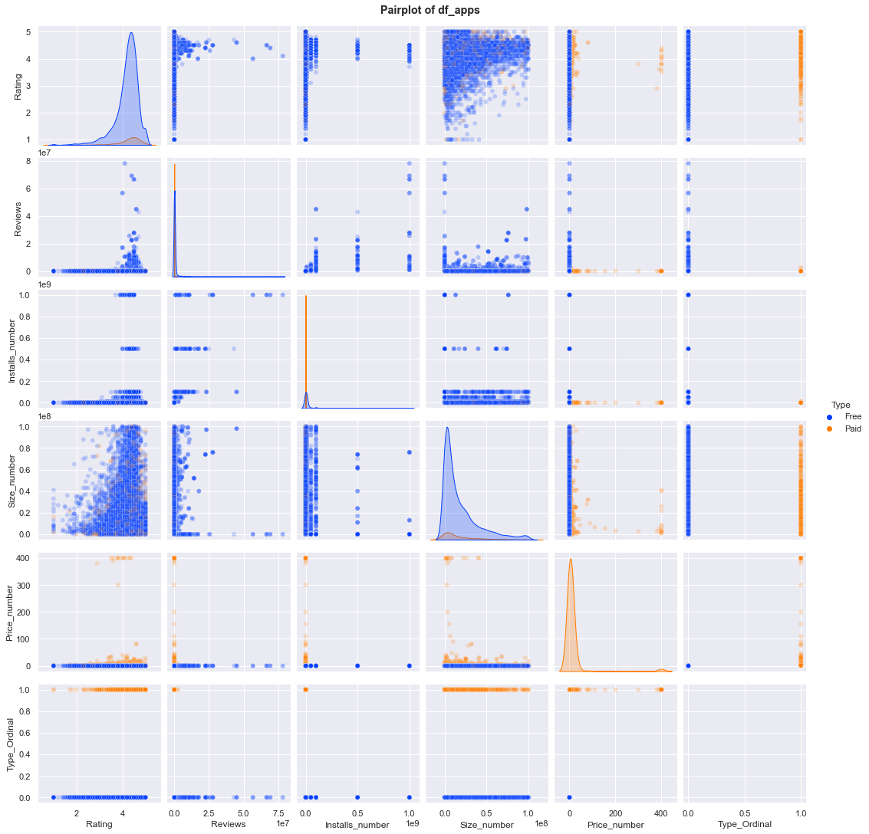
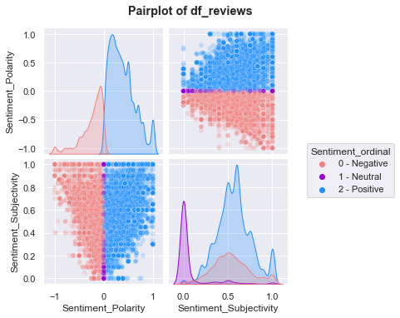
Data Exploration

Slide 4
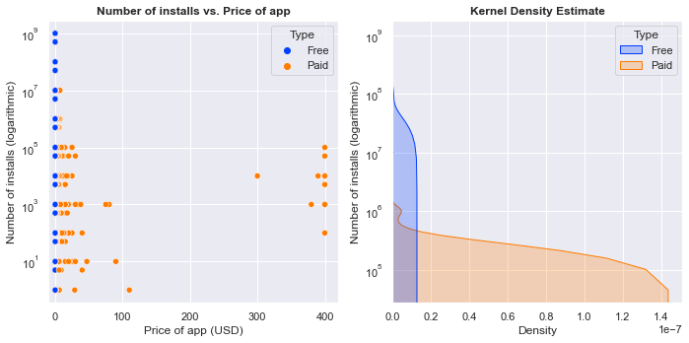
Data Exploration
Users install less paid apps then free apps

Slide 5
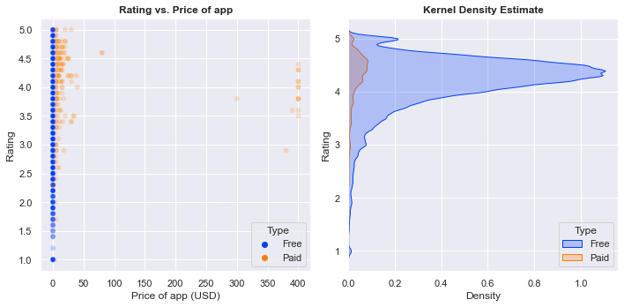
Data Exploration
Rating distribution between free and paid apps is similar
(Scatter plot shows different trend – importance of KDE)

Slide 6
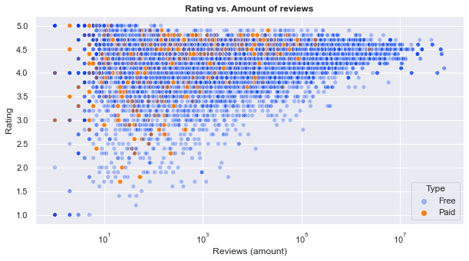
Data Exploration
Users review free and paid apps similarly
(with higher number of reviews of free apps)

Slide 7
Regression Model Comparison (No Hyper-parameter Optimization)
Rating ~ Sentiment + Reviews + Installs + Size + Price
Model | Test RMSE | R2 score
Linear Regression | 0.28 | 0.03
Random Forest | 0.26 | 0.14
XGBoost | 0.19 | 0.57

Slide 8
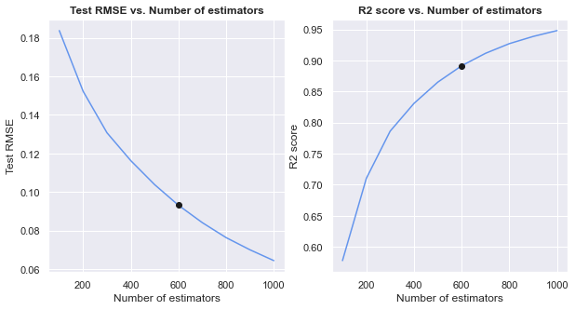
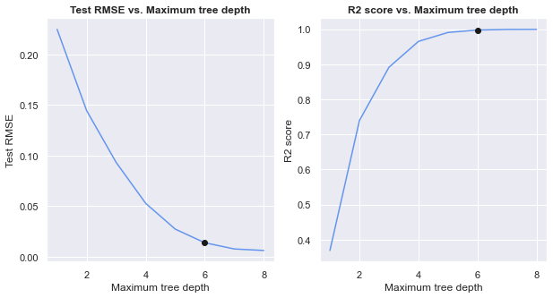
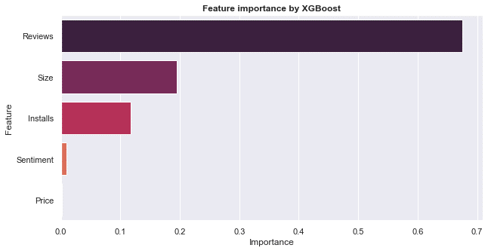
XGBoost Hyper-parameter Optimization
Model | Test RMSE | R2 score
Non-optimized XGBoost | 0.19 | 0.57
Optimized XGBoost | 0.02 | 1.00

